Slide 1
Fintech 545
Assignment5
Oct 21

Slide 2
Problem 1
Assume you a call and a put option with the following
-Current Stock Price 165
-Current Date 02/25/2022
-Options Expiration Date 03/18/2022
-Risk Free Rate of 0.25%
-Continuously Compounding Coupon of 0.53%
Calculate the time to maturity using calendar days(not trading days). For a range of implied volatilities between 10% and 80%, plot the values of the call and the put. Discuss these graphs. How does the supply and demand affect the implied volatilities?

Slide 3
Black-scholes implementation
def d1(S,X,b,sigma,T):
return (np.log(S/X)+(b+sigma**2/2)*T)/sigma/T**0.5
def d2(S,X,b,sigma,T):
return d1(S,X,b,sigma,T)-sigma*T**0.5
def bs_call(S,b,r,T,X,sigma):
return S*np.exp((b-r)*T)*norm.cdf(d1(S,X,b,sigma,T))-X*np.exp(-r*T)*norm.cdf(d2(S,X,b,sigma,T))
def bs_put(S,b,r,T,X,sigma):
return X*np.exp(-r*T)*norm.cdf(-d2(S,X,b,sigma,T))-S*np.exp((b-r)*T)*norm.cdf(-d1(S,X,b,sigma,T))

Slide 4
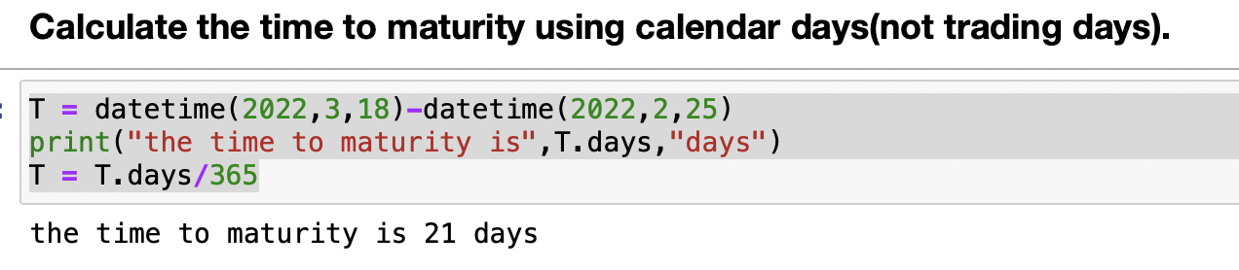

Slide 5
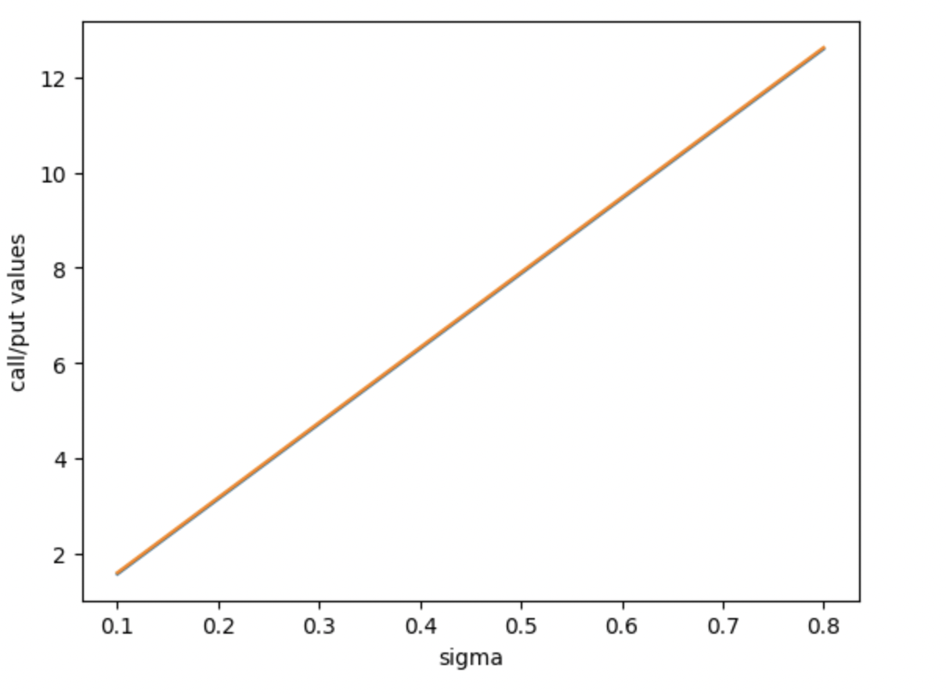
Result

Slide 6
Conclusion
The call/put values and the sigma are positively correlated. As sigma increases, the values increase. No matter what the volalities is, there is a same probability to go either direction which makes the put/call values being the same with the same volatilities.
Demand>Supply, volatilities decrease
Supply>Demand, volatilities increase

Slide 7
Problem 2
Use the options found in AAPL_Options.csv
-Current AAPL price is 164.85
-Current Date, Risk Free Rate and Divident Rate are the same as problem 1.
Calculate the implied volatility for each option.Plot the implied volatility vs the strike price for Puts and Calls. Discuss the shape of these graphs. What market dynamics could make these graphs?There are bonus points available on this question based on your discussion. Take some time to research if needed.

Slide 8
Implied volatility function
def implied_vol_call(S,b,r,T,X,price):
f1 = lambda z: (bs_call(S,b,r,T,X,z)-price)
return fsolve(f1, x0 = 0.2)[0]
def implied_vol_put(S,b,r,T,X,price):
f1 = lambda z: (bs_put(S,b,r,T,X,z)-price)
return fsolve(f1, x0 = 0.2)[0]

Slide 9
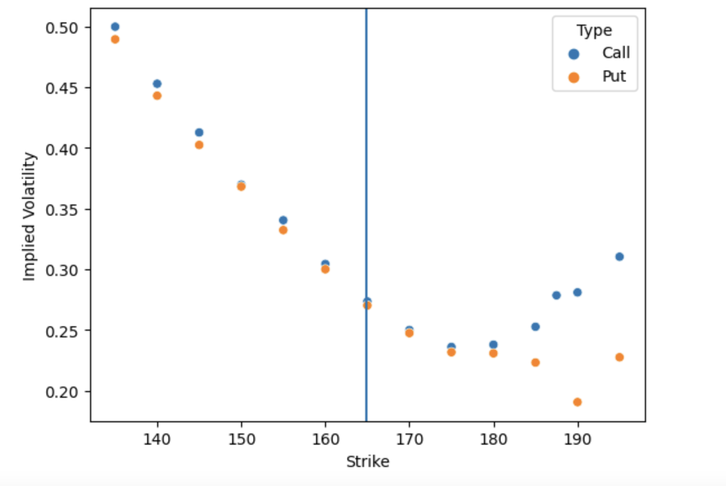

Slide 10
Conclusion
The market dynamic here is volatility smirk(reverse skew). As this graph shows, at the lower strike price, the implied volatility for calls/puts is higher than that of the higher strike price which means that in-the-money calls and out-of-the-money puts are more expensive compared to out-of-the-money calls and in-the-money puts.

Slide 11
Problem 3
Use the portfolios found in problem3.csv
-Current AAPL price is 164.85
-Current Date, Risk Free Rate and Dividend Rate are the same as problem1.
For each of the portfolios, graph the portfolio value over a range of underlying values. Plot the portfolio values and discuss the shapes. Bonus points available for typing these graphs to other topics discussed in the lecture.Using DailyReturn.csv. Fit a Normal distribution to AAPL returns - assume 0 mean return.Simulate AAPL returns 10 days ahead and apply those returns to the current AAPL price(above). Calculate Mean, VaR and ES. Discuss.

Slide 12
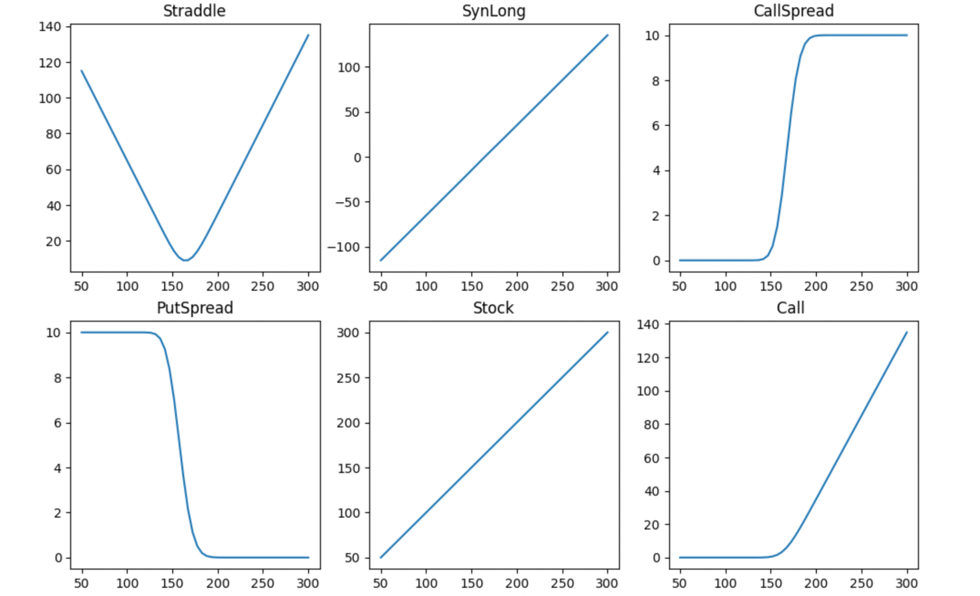

Slide 13
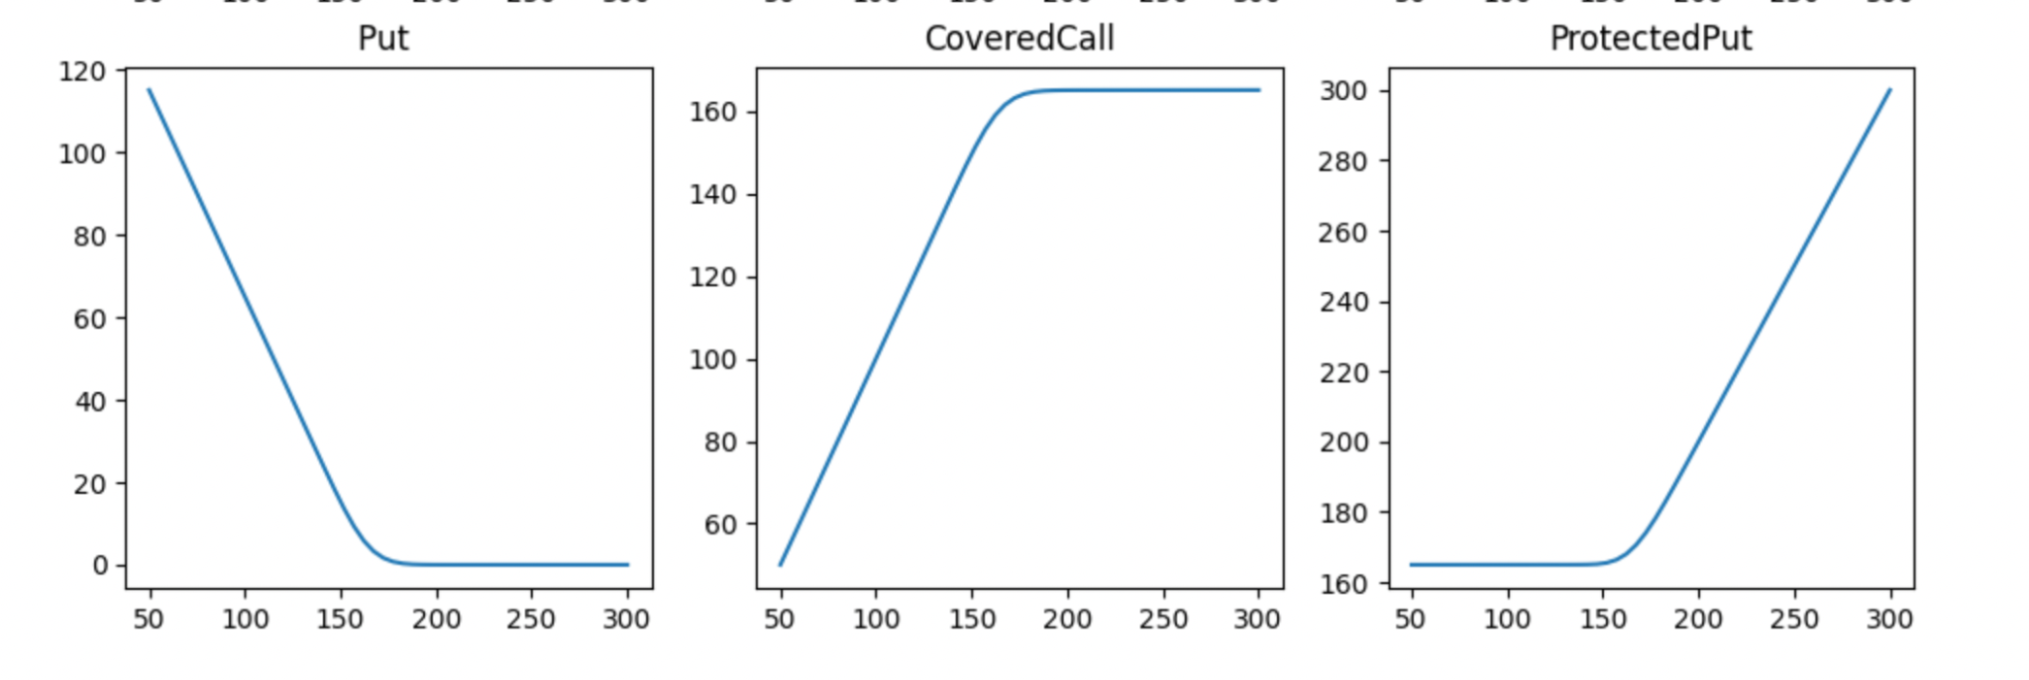

Slide 14
Call, Put, Stock: normal behaviors for Call, Put and Stock
Straddle: Hold a long Call and a long Put for the same strike price and the same maturity. It will make profit when underlying price moves in either direction and will have a higher return if the underlying price moves further in either direction(high volatility)
SynLong: Holds a long Call and a short Put for the same strike price and the same maturity. It behaves like a Stock but the initial portfolio value is 0.
CallSpread: Holds a long Call and a short Call for a higher strike price and the same maturity. It will make profit when the underlying price goes up and lose money if the underlying price goes up but there is a limit for both gain and loss.
PutSpread: Holds a long Put and a short Put for a lower strike price and the same maturity. It will make profit when the underlying price goes down and lose money if the underlying price goes up but there is a limit for both gain and loss.
Covered Call: Holds a Stock and a short Call with the same strike price and the same maturity. It has a ceiling for profits.
Protected Cut: Holds a STock and a long Put with the same strike price and the same maturity. It has a floor for loss.

Slide 15
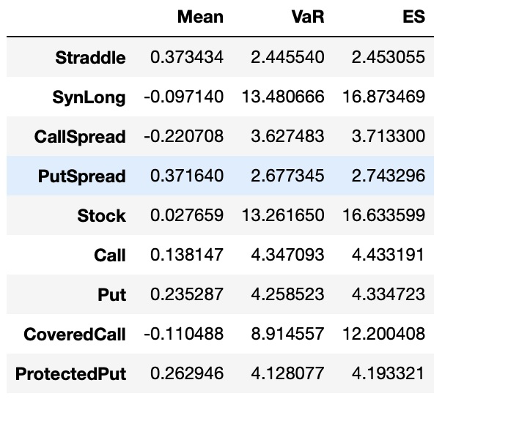

Slide 16
Conclusion
All portfolios have the expected return to be around 0. Straddle, PutSpread has the highest mean and CallSpread has the worst mean in my simulation. SynLong and Stock are really risky. They have VaR around 13 and ES around 16. CoveredCall has a moderate risk with VaR around 9 and ES around 12. Other portfolios have small risks. Their VaR and ES are between 2 and 5.

